Slide 1

Fake Reviews Detection
——Noah

Slide 2
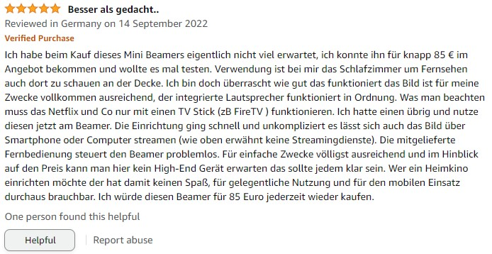
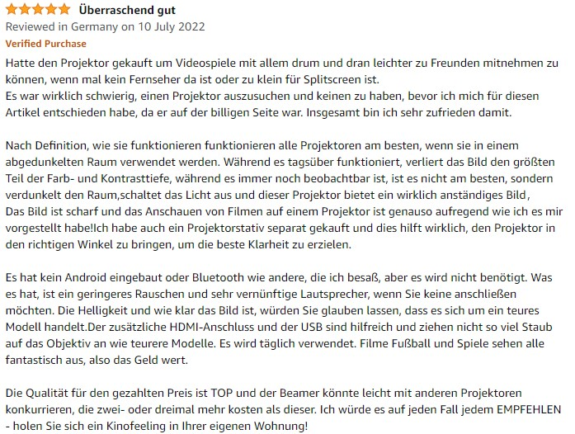

Slide 3

Quiz

Slide 4
CG
1. Arrived quickly, was just as described. The case is comfortable and looks nice.

Slide 5
2. An early and unexpected bereavement, an unexpected loss, and a surprising return to a life of adventure. I had a lot of fun with this book and I‘m sure it will be a good read for all of us
CG

Slide 6
3. What's the next book in the series I got left hanging on a limb. I would have liked an explanation of why these bad cops did what they did.
OR

Slide 7
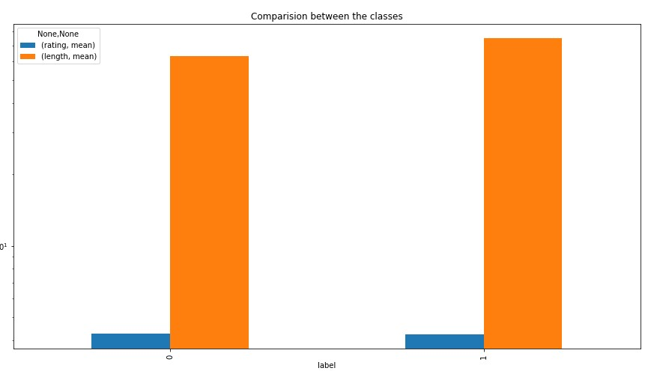

Slide 8
I was not familiar with this movie, but it is a great movie for a beginner to intermediate. I really enjoyed the movie. The characters and the story were great. The acting was great. The acting was great. The acting was good. The acting was good. The acting was good. The acting was good. The acting was good. The acting was good. The acting was good. The acting was good. The acting was good. The acting was good. The acting was good. The acting was good. The acting was good. The acting was good. The acting was good. The acting was good. The acting was good. The acting was good. The acting was good. The acting was good. The acting was good. The acting was good. The acting was good. The acting was good. The acting was good. The acting was good. The acting was good. The acting was good. The acting was good. The acting was good. The acting was good. The acting was good. The acting was good. The acting was good. The acting was good. The acting was good. The acting was good. The acting was good.

Slide 9
"I try not to live this way, but it is a real shame that I have been living this way for so long. I am a firm believer that if you don't get it right, it can ruin your life. I am a big fan of the author and I would not want to put him down. I will read his other books soon and hope to see how he develops. I just can't imagine living this way. This book is one of the most entertaining and entertaining books I have read in a long time. I enjoyed reading it. I just couldn't put it down and am looking forward to the next one. This book is a must-read for all of us. I would recommend it to anyone who enjoys reading. I like how it is written. It is funny, it is tough to put down. There are so many surprises. I enjoyed the book a lot. I would recommend it to anyone. A wonderful book about how to create a good life. I loved the characters and the writing style. I was able to relate to them very well and the story was well told. I loved reading about the people that were involved in this business. I also liked the way the book was told and told by one of the characters. I highly recommend this book to anyone. I am a huge fan of Ann Coulter and this book is no exception. I read a lot of her books and have read a lot of her books. I liked the writing style

Slide 10
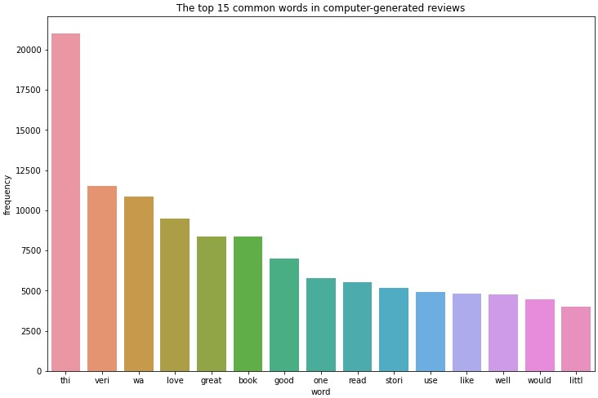
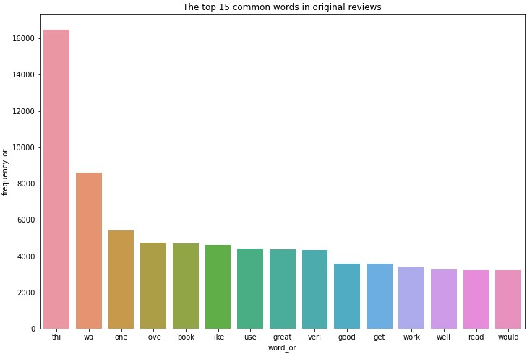

Slide 11
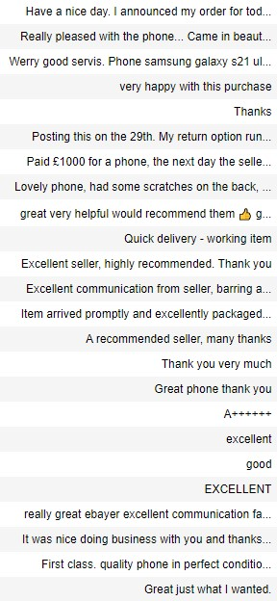

Slide 12
Improvement
Enriching my original dataset
Comparing with the sentiment NLP model

Slide 13
Thank you for your attention

